Slide 1
Singularities
Tomasz Karolak, Eric Schubert, Chris Taggeselle

Slide 2
Structure
Explanation
Wrist
Overhead

Slide 3
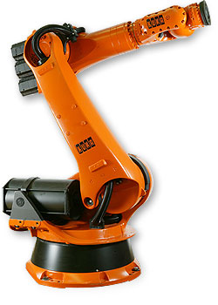
Singularities for 6 DOF
Can appear on several points
Arrangements that have infinite solutions
2 Types of singularities
Wrist
Overhead
Explanation with example of KR30

Slide 4
6 DOF robot arm and sketch
d5
A6
A5
α₆
d3
A4
α₅
α₃
A3
α₄
d2
A2
α₂
d1
A1
α₁

Slide 5
Wrist singularity
d5
A6
A5
d3
A4
A3
A2
A1

Slide 6

Wrist singularity

Slide 7
Wrist singularity
Appearance:
Calculate (wrist position) and
If
Pseudocode:
Solution:
What does the other group says???

Slide 8
Overhead singularity
α₅
d5
d3
A5
A6
A4
α₃
α₄
α₆
A3
d2
A2
α₂
d1
A1
α₁

Slide 9

Overhead singularity

Slide 10
Overhead singularity
Appearance:
Calculate (wrist position) in base coordinates
If and
Pseudocode:
Solution:
What does the other group says???

Slide 11
Full Video

Slide 12
Kuka Kr 30 - DOF

Slide 13
Description of the sketch
d5
A6
A5
α₆
d3
A4
α₅
α₃
A3
α₄
d2
A2
α₂
d1
A1
α₁

